Slide 1






Mediation and Fuzzy Mediation Analysis
for Multiple Covariates and
Its Applications to Solar Power Data
Department of Mathematics and Statistics, Sejong University
Department of Digital Content, Sejong University
Jungeun Lee, Yeonkyung Lee, Sung Wook Baik and Jin Hee Yoon

Slide 2
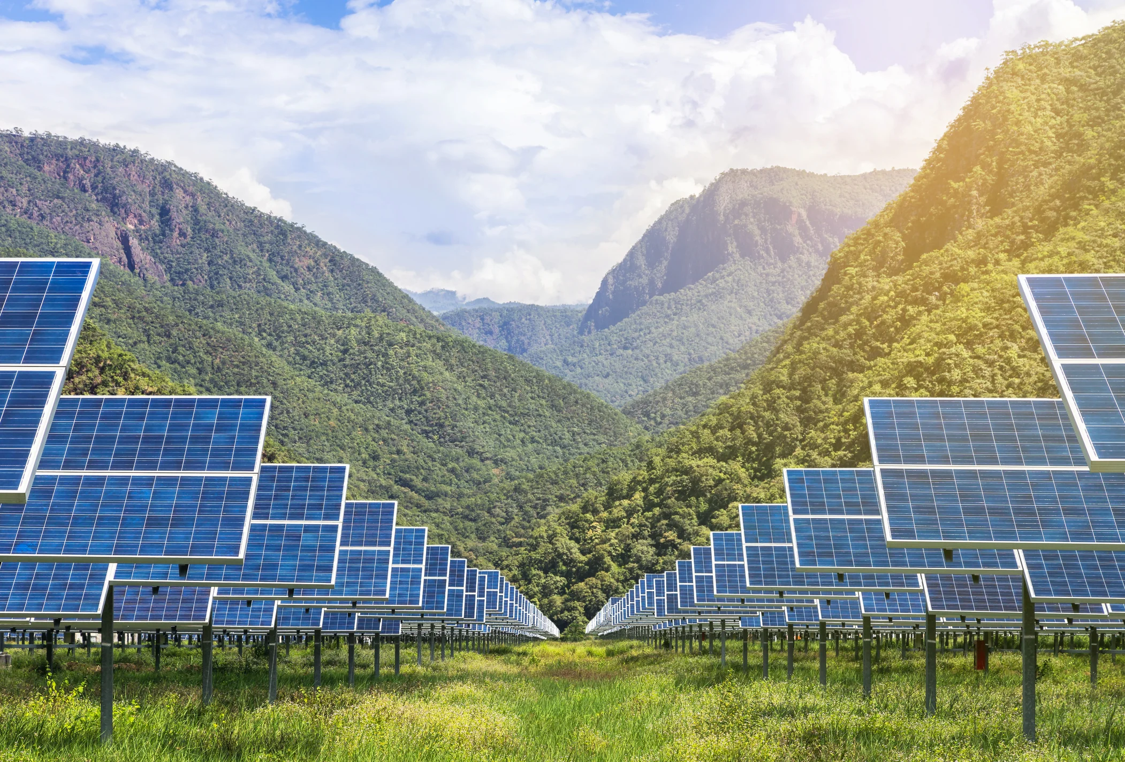


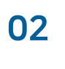



Introduction
Preliminaries
Main Contribution
Background
Mediation Analysis
Data Preprocessing
Need for study
Fuzzification
Modeling relationship of data
Fuzzy Mediation Analysis
Results
Conclusion
Comparison of effects of
CMA & FMA
Summary
Significance Test of effects of CMA & FMA

Slide 3




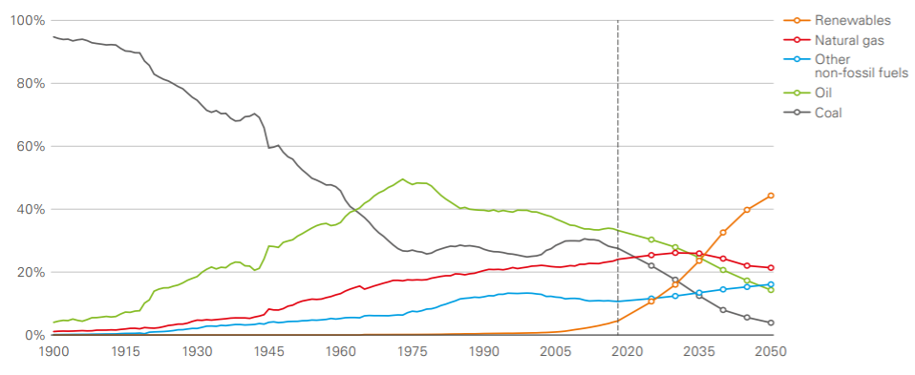




Introduction
Preliminaries
Our study
Result
Conclusion
Background
BP, Energy Outlook 2020 edition
PROS
Safe
Infinite resource
Restriction-free site
Long life
☞ Easy to recess
CONS
Highly fluctuating
☞ Hard to predict
It is important to predict accurate amount of solar power.
http://energytransitionkorea.org/sites/default/files/2020-09/bp-energy-outlook-2020.pdf

Slide 4





Introduction
Preliminaries
Our study
Result
Conclusion
Need for research
01 The focus of prior research with solar power data
Lack of research on the relationships between variables
- ARMA, ARIMA
- SVM, ANN, LSTM
Need for extend independent variable to multiple version
Need for reflect ambiguity of data
02 The focus of prior mediation study
Absence of mediation model with multiple covariates
03 Characteristics of solar power data
Ambiguity, the key characteristic of climate data
Fuzzy Mediation Analysis with multiple covariates

Slide 5



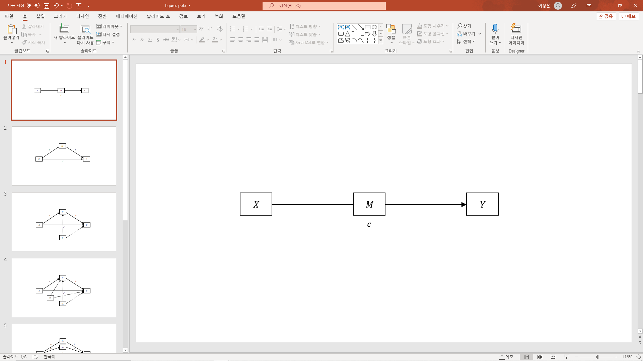




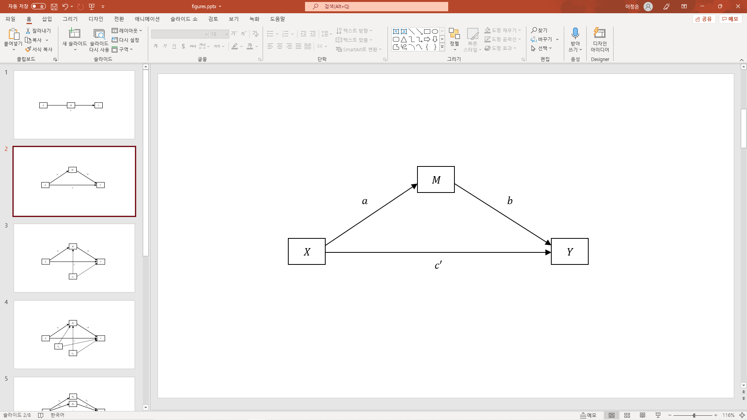
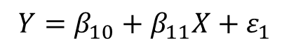
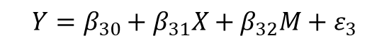
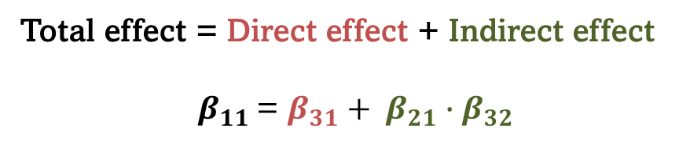
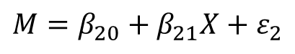
Introduction
Preliminaries
Our study
Result
Conclusion
Mediation Analysis
Simple Mediation Analysis by Baron and Kenny(1986)
$$Y=β_{10}+β_{11}X+ε_{1}$$
$$M=β_{20}+β_{21}X+ε_{2}$$
$$Y=β_{30}+β_{31}X+β_{32}M+ε_{3}$$
Total effect = Direct effect + Indirect effect
$β_{11}$ = ${{β_{31}+ β}_{21}∙β}_{32}$
https://psycnet.apa.org/buy/1987-13085-001

Slide 6
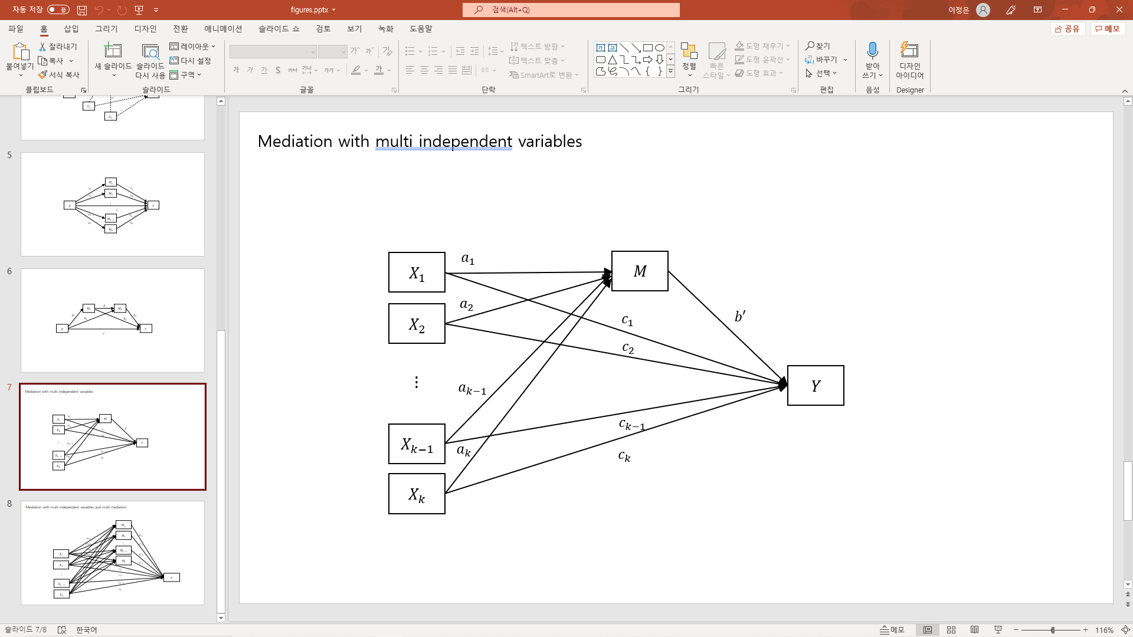
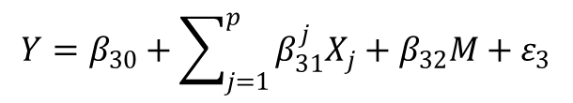
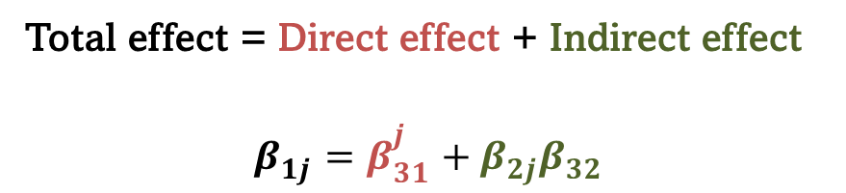
Introduction
Preliminaries
Our study
Result
Conclusion
Mediation Analysis
Mediation Analysis for multiple covariates with one mediator
$$Y=β_{10}+β_{11}X_{1}+β_{12}X_{2}+⋯+β_{1p}X_{p}+ε_{1}$$
$$M=β_{20}+β_{21}X_{1}+β_{22}X_{2}+⋯+β_{2p}X_{p}+ε_{2}$$
$$Y=β_{30}+\sum_{j=1}^{p}{β_{31}^{j}X_{j}}+β_{32}M+ε_{3}$$
Total effect = Direct effect + Indirect effect
$$β_{1j}=β_{31}^{j}+β_{2j}β_{32}$$

Slide 7
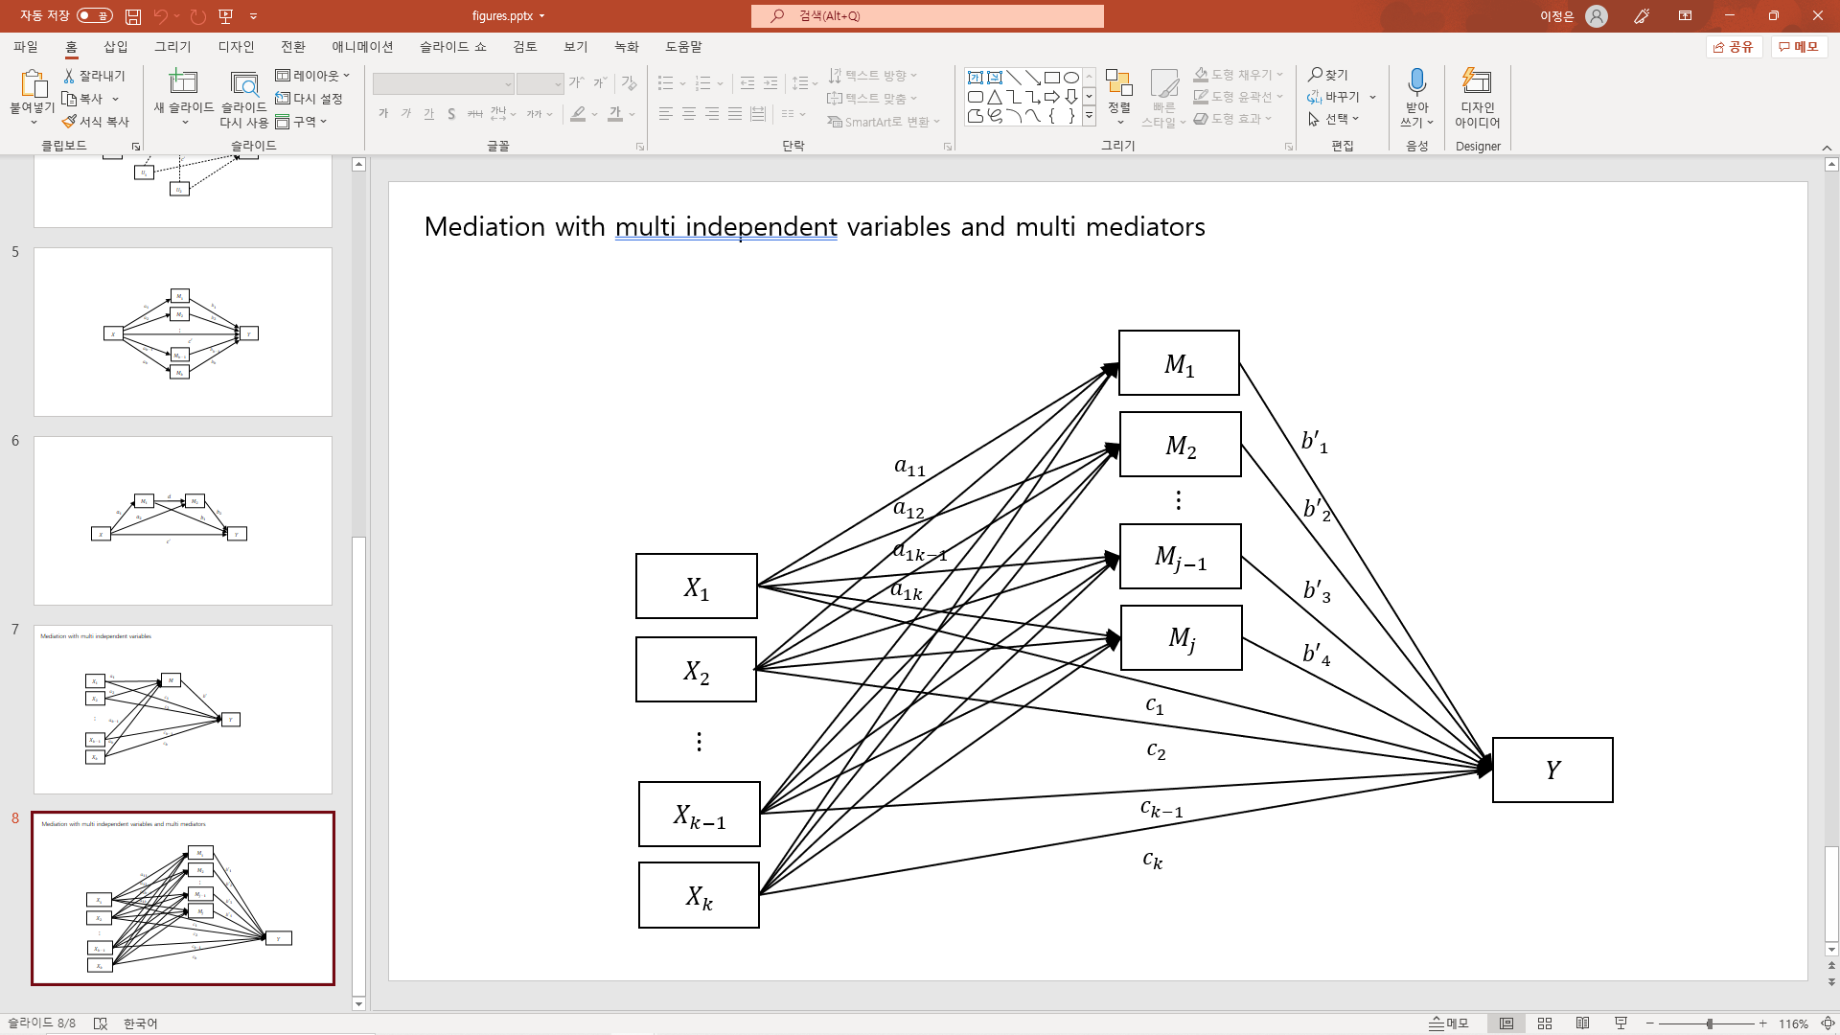

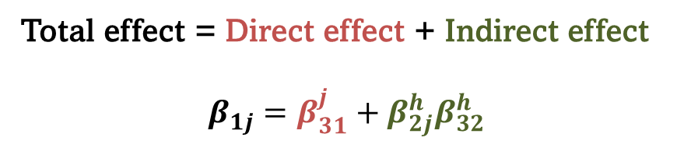
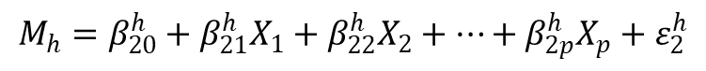
Introduction
Preliminaries
Our study
Result
Conclusion
Mediation Analysis
Mediation Analysis for multiple covariates with multiple mediators
$$Y=β_{10}+β_{11}X_{1}+β_{12}X_{2}+⋯+β_{1p}X_{p}+ε_{1}$$
$$M_{h}=β_{20}^{h}+β_{21}^{h}X_{1}+β_{22}^{h}X_{2}+⋯+β_{2p}^{h}X_{p}+ε_{2}^{h}$$
$$Y=β_{30}+\sum_{j=1}^{p}{β_{31}^{j}X_{j}}+\sum_{h=1}^{k}{β_{32}^{h}M_{h}}+ε_{3}$$
Total effect = Direct effect + Indirect effect
$$β_{1j}={{β_{31}^{j}+β}_{2j}^{h}β}_{32}^{h}$$

Slide 8
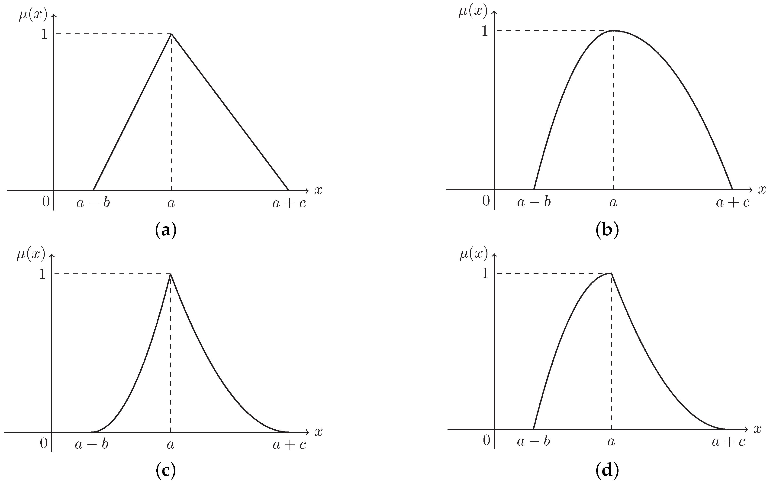
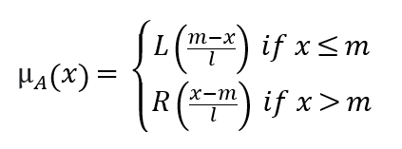
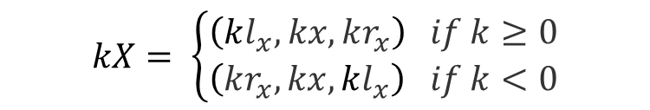
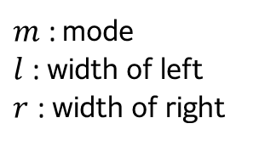
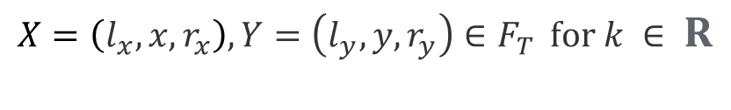
Introduction
Preliminaries
Our study
Result
Conclusion
Fuzzification
Fuzzy numbers by Zadeh (1986)
L-R fuzzy numbers
$m$ : mode
$l$ : width of left
$r$ : width of right
$$X=\left(l_{x},x,r_{x}\right), Y=\left(l_{y},y,r_{y}\right)∈F_{T } for k ∈ R$$
$X ⊕ Y$ = ($l_{x}+ l_{y}, x+y, r_{x}+ r_{y})$
$$kX= \left\{\begin{aligned}\left(kl_{x},kx,kr_{x}\right) if k≥0 \\ \left(kr_{x},kx,kl_{x}\right) if k<0\end{aligned}\right.$$
https://www.mdpi.com/1099-4300/21/7/697

Slide 9
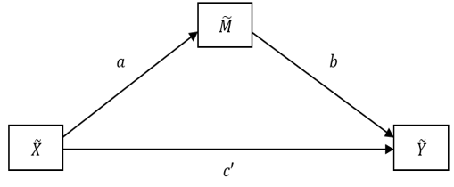
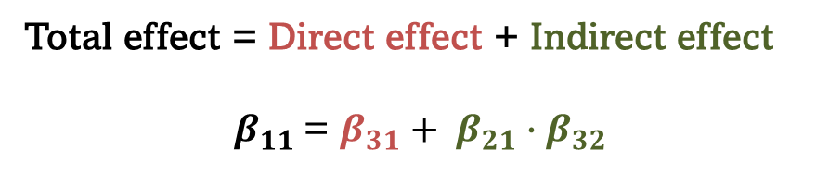
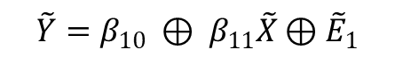
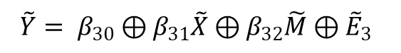
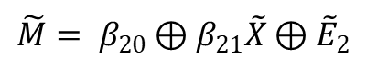
Introduction
Preliminaries
Our study
Result
Conclusion
Fuzzy Mediation Analysis
Simple fuzzy mediation by Yoon (2020)
$$\tilde{Y}=β_{10} ⊕ β_{11}\tilde{X}⊕{\tilde{E}}_{1}$$
$$\tilde{M}= β_{20}⊕β_{21}\tilde{X}⊕{\tilde{E}}_{2}$$
$$\tilde{Y}= β_{30}⊕β_{31}\tilde{X}⊕β_{32}\tilde{M}⊕{\tilde{E}}_{3}$$
Total effect = Direct effect + Indirect effect
$β_{11}$ = ${{β_{31}+ β}_{21}∙β}_{32}$
https://link.springer.com/article/10.1007/s40815-019-00727-6

Slide 10
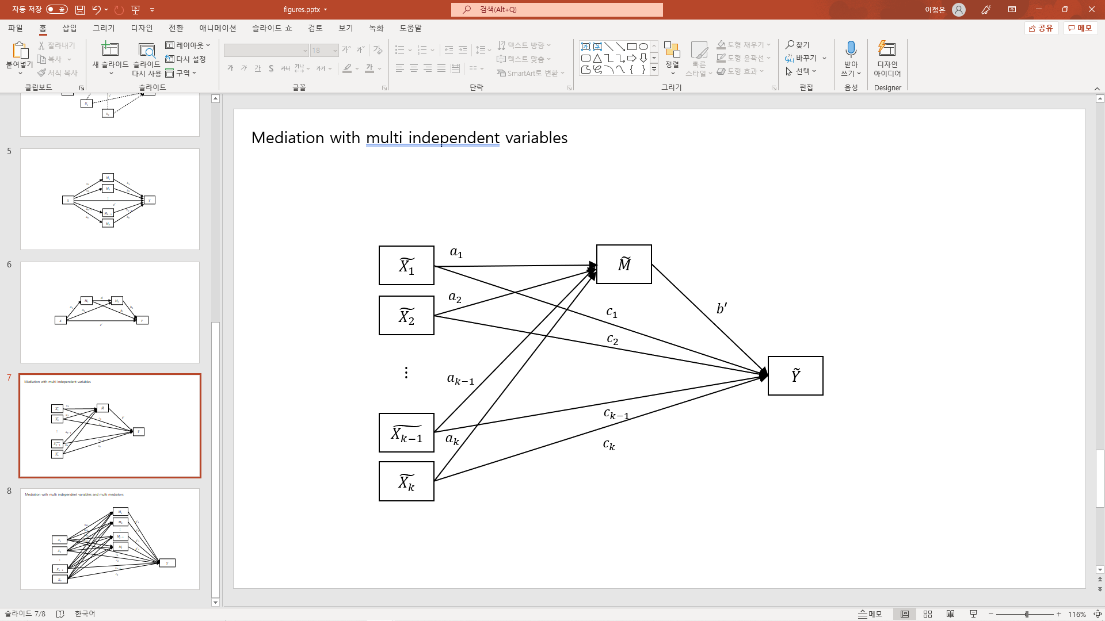
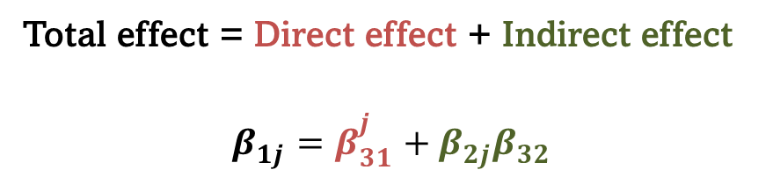


Introduction
Preliminaries
Our study
Result
Conclusion
Fuzzy Mediation Analysis
Fuzzy Mediation Analysis for multiple covariates with one mediator
$$\tilde{Y}=β_{10}⊕β_{11}{\tilde{X}}_{1}⊕⋯⊕β_{1p}{\tilde{X}}_{p}⊕{\tilde{E}}_{1},$$
$$\tilde{M}= β_{20}⊕β_{21}{\tilde{X}}_{1}⊕⋯⊕β_{2p}{\tilde{X}}_{p}⊕{\tilde{E}}_{2}$$
$$\tilde{Y}= β_{30}⊕\sum_{j=1}^{p}{β_{31}^{j}\tilde{X_{j}}}⊕β_{32}\tilde{M}⊕{\tilde{E}}_{3}$$
Total effect = Direct effect + Indirect effect
$$β_{1j}=β_{31}^{j}+β_{2j}β_{32}$$

Slide 11


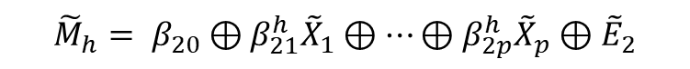
Introduction
Preliminaries
Our study
Result
Conclusion
Fuzzy Mediation Analysis
Fuzzy Mediation Analysis for multiple covariates with multiple mediators
$$\tilde{Y}=β_{10}⊕β_{11}{\tilde{X}}_{1}⊕⋯⊕β_{1p}{\tilde{X}}_{p}⊕{\tilde{E}}_{1}$$
$${\tilde{M}}_{h}= β_{20}⊕β_{21}^{h}{\tilde{X}}_{1}⊕⋯⊕β_{2p}^{h}{\tilde{X}}_{p}⊕{\tilde{E}}_{2}$$
$$\tilde{Y}= β_{30}⊕\sum_{j=1}^{p}{β_{31}^{j}\tilde{X_{i}}}⊕\sum_{h=1}^{k}{β_{32}^{h}{\tilde{M}}_{h}}⊕{\tilde{E}}_{3}$$
Total effect = Direct effect + Indirect effect
$$β_{1j}={{β_{31}^{j}+β}_{2j}^{h}β}_{32}^{h}$$

Slide 12


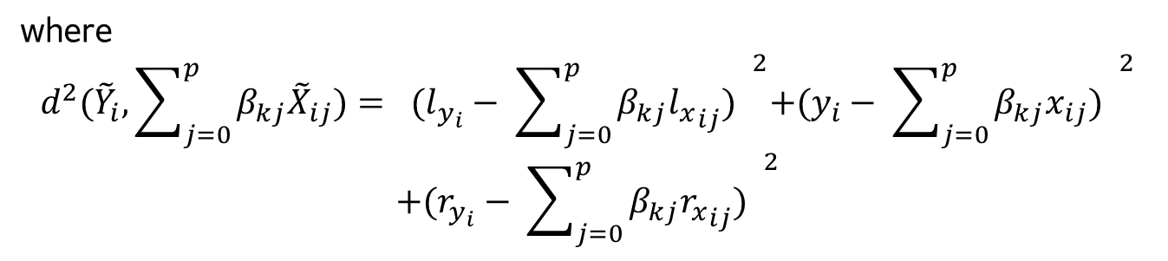
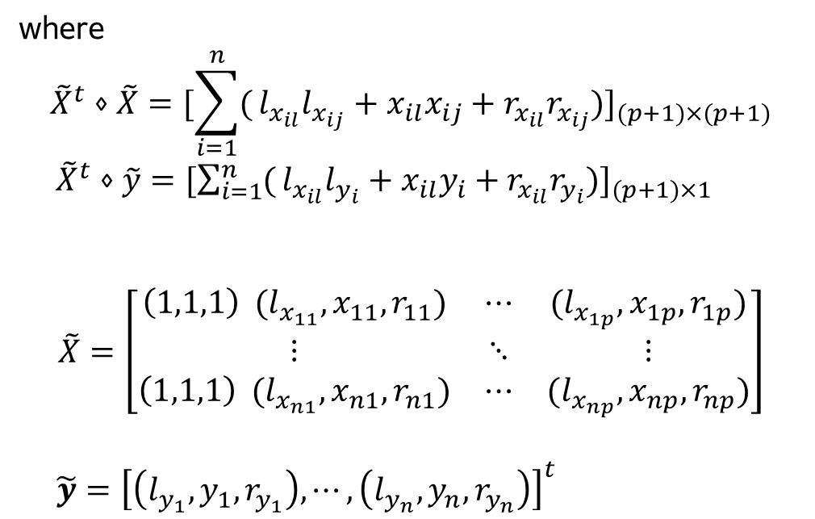
Introduction
Preliminaries
Our study
Result
Conclusion
Estimation in Fuzzy Mediation Analysis
LSE Method
$$\tilde{Y_{i}}=β_{0}⨁β_{1}{\tilde{X}}_{1i}⨁β_{2}{\tilde{X}}_{2i}⨁⋯⨁β_{p}{\tilde{X}}_{pi}⨁\tilde{E_{i}}$$
$$\hat{β_{k}}={\left({\tilde{X}}^{t}⋄\tilde{X}\right)}^{−1}{\tilde{X}}^{t}⋄\tilde{y}$$
$$Q\left(β_{k0,}β_{k1,}{…,β}_{kp,}\right)=\sum_{i=1}^{n}{d^{2}({\tilde{Y}}_{i}, \sum_{j=0}^{p}{β_{kj}{\tilde{X}}_{ij}) → }} \frac{∂Q}{∂β_{kl}}=0$$
where
$${\tilde{X}}^{t}⋄\tilde{X}={[\sum_{i=1}^{n}{(}l_{x_{il}}l_{x_{ij}}+x_{il}x_{ij}+r_{x_{il}}r_{x_{ij}})]}_{(p+1)×(p+1)}$$
${\tilde{X}}^{t}⋄\tilde{y}={[\sum_{i=1}^{n}{(}l_{x_{il}}l_{y_{i}}+x_{il}y_{i}+r_{x_{il}}r_{y_{i}})]}_{(p+1)×1}$
$$\tilde{X}=\left[\begin{matrix}\left(1,1,1\right) (l_{x_{11}},x_{11},r_{11}) & ⋯ & (l_{x_{1p}},x_{1p},r_{1p}) \\ ⋮ & ⋱ & ⋮ \\ \left(1,1,1\right) (l_{x_{n1}},x_{n1},r_{n1}) & ⋯ & (l_{x_{np}},x_{np},r_{np})\end{matrix}\right]$$
$\tilde{y}={\left[\left(l_{y_{1}},y_{1},r_{y_{1}}\right), ⋯,\left(l_{y_{n}},y_{n},r_{y_{n}}\right)\right]}^{t}$
where
$$d^{2}({\tilde{Y}}_{i}, \sum_{j=0}^{p}{β_{kj}{\tilde{X}}_{ij})= {(l_{y_{i}}− \sum_{j=0}^{p}{β_{kj}{l_{x}}_{ij}) }}^{2}+{(y_{i}− \sum_{j=0}^{p}{β_{kj}x_{ij}) }}^{2}}$$
$$+{(r_{y_{i}}− \sum_{j=0}^{p}{β_{kj}{r_{x}}_{ij}) }}^{2}$$
$$d^{2}\left(X,Y\right)=D_{2}^{2}\left(Supp X, Supp Y\right)+{\left[m_{l}\left(X\right)−m_{l}\left(Y\right)\right]}^{2}+{\left[m_{r}\left(X\right)−m_{r}\left(Y\right)\right]}^{2}$$

Slide 13
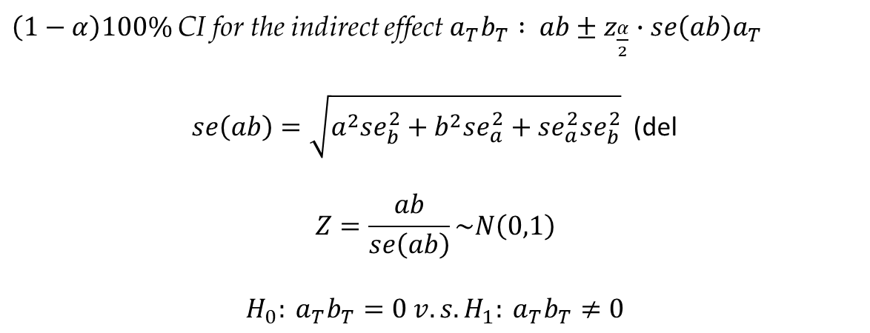
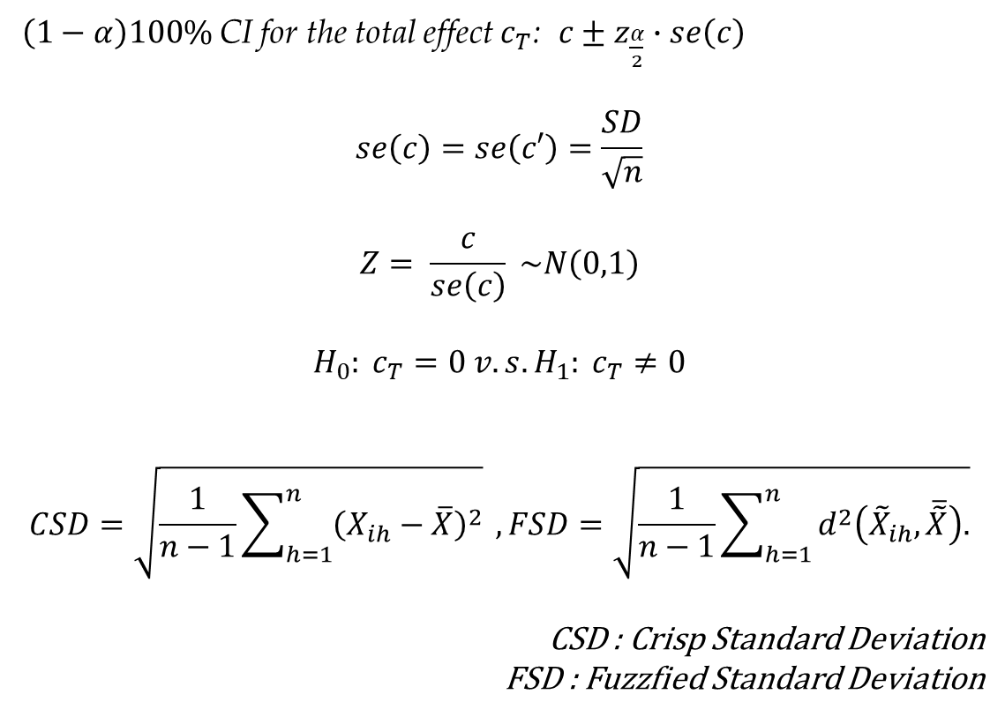
Introduction
Preliminaries
Our study
Result
Conclusion
Inference of the effects
Step 01
Inference of Total effect and Direct effect
Inference of Indirect effect
Step 02
$\left(1−α\right)100\%$CI for the total effect $c_{T}$: $c±z_{\frac{α}{2}}∙se\left(c\right)$
$$se\left(c\right)=se\left(c′\right)=\frac{SD}{\sqrt{n}}$$
$$Z= \frac{c}{se\left(c\right)} \sim N\left(0,1\right)$$
$$H_{0}: c_{T}=0 v.s. H_{1}: c_{T}≠0$$
$$CSD=\sqrt{\frac{1}{n−1}\sum_{h=1}^{n}{{\left(X_{ih}−\overline{X}\right)}^{2}}} , FSD=\sqrt{\frac{1}{n−1}\sum_{h=1}^{n}{d^{2}\left({\tilde{X}}_{ih},\overline{\tilde{X}}\right).}}$$
CSD : Crisp Standard Deviation
FSD : Fuzzfied Standard Deviation
$\left(1−α\right)100\%$CI for the indirect effect $a_{T}b_{T} :$ $ab±z_{\frac{α}{2}}∙se\left(ab\right)a_{T}$
$se\left(ab\right)=\sqrt{a^{2}se_{b}^{2}+b^{2}se_{a}^{2}+se_{a}^{2}se_{b}^{2}}$ (del
$$Z=\frac{ab}{se\left(ab\right)}\sim N\left(0,1\right)$$
$$H_{0}: a_{T}b_{T}=0 v.s. H_{1}: a_{T}b_{T}≠0$$

Slide 14
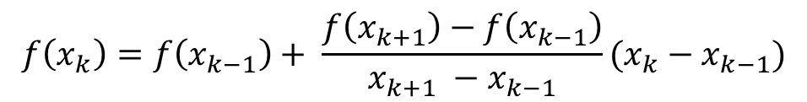

Introduction
Preliminaries
Our study
Result
Conclusion
1. Data Preprocessing
Climate condition data in Dangjin, Korea
Every hour from 1 a.m., Jan 1, 2015, to 11 p.m., Dec 31, 2017
Step 01
Significance Test for independent variables
Linear interpolation for missing values
Step 02
temp, rain, wind_speed, humidity, solar radiation, sun hour, snow, cloud, solar power
☞ all significant
$$f\left(x_{k}\right)=f\left(x_{k−1}\right)+ \frac{f\left(x_{k+1}\right)−f\left(x_{k−1}\right)}{x_{k+1} −x_{k−1}}(x_{k}−x_{k−1})$$
Normalization
Step 04
Step 03
Fuzzification
Date | Crisp | m, l, r | Fuzzified
01-01-2015 1:00AM | -4.4 | m : -4.4, l, r : |-4.6-(-4.4)|/2 = 0.1 | (-4.5,-4.4,-4.3)
01-02-2015 2:00AM | -4.6 | m : -4.6, l, r : |-4.7-(-4.6)|/2 = 0.05 | (-4.65, -4.6, -4.55)
01-03-2015 3:00AM | -4.7 | m : -4.7, l, r : |-5-(-4.7)|/2 = 0.15 | (-4.85, -4.7, -4.55)
$$x= \frac{x_{0}−x_{min}}{x_{max}−x_{min}}$$

Slide 15
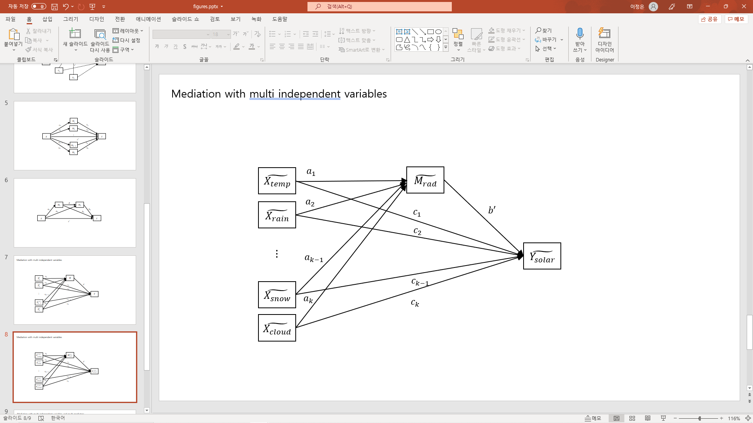
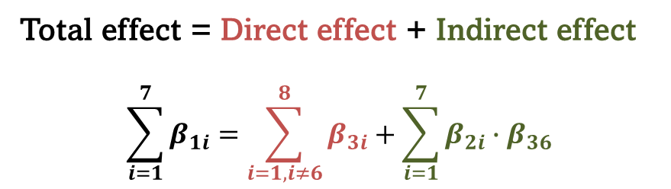
Introduction
Preliminaries
Our study
Result
Conclusion
2. Modeling with solar power data
Fuzzy Mediation Analysis for multiple covariates with one mediator
$$\tilde{Y}=β_{10} ⊕β_{11}\tilde{X_{1}}⊕β_{12}\tilde{X_{2}}⊕β_{13}\tilde{X_{3}}⊕β_{14}\tilde{X_{4}}⊕β_{15}\tilde{X_{5}}⊕β_{16}\tilde{X_{6}}⊕β_{17}\tilde{X_{7}}+ε_{1}$$
$$\tilde{M}=β_{20} ⊕β_{21}\tilde{X_{1}}⊕β_{22}\tilde{X_{2}}⊕β_{23}\tilde{X_{3}}⊕β_{24}\tilde{X_{4}}⊕β_{25}\tilde{X_{5}}⊕β_{26}\tilde{X_{6}}⊕β_{27}\tilde{X_{7}}+ε_{2}$$
$$\tilde{Y}=β_{30} ⊕β_{31}\tilde{X_{1}}⊕β_{32}\tilde{X_{2}}⊕β_{33}\tilde{X_{3}}⊕β_{34}\tilde{X_{4}}⊕β_{35}\tilde{X_{5}}⊕β_{36}\tilde{M_{6}}⊕β_{37}\tilde{X_{7}}⊕β_{38}\tilde{X_{8}}+ε_{3}$$
Total effect = Direct effect + Indirect effect
$$\sum_{i=1}^{7}{β_{1i}}=\sum_{i=1,i≠6}^{8}{β_{3i}}+\sum_{i=1}^{7}{β_{2i}}∙β_{36}$$
temp : temperature
rad : solar radiation

Slide 16
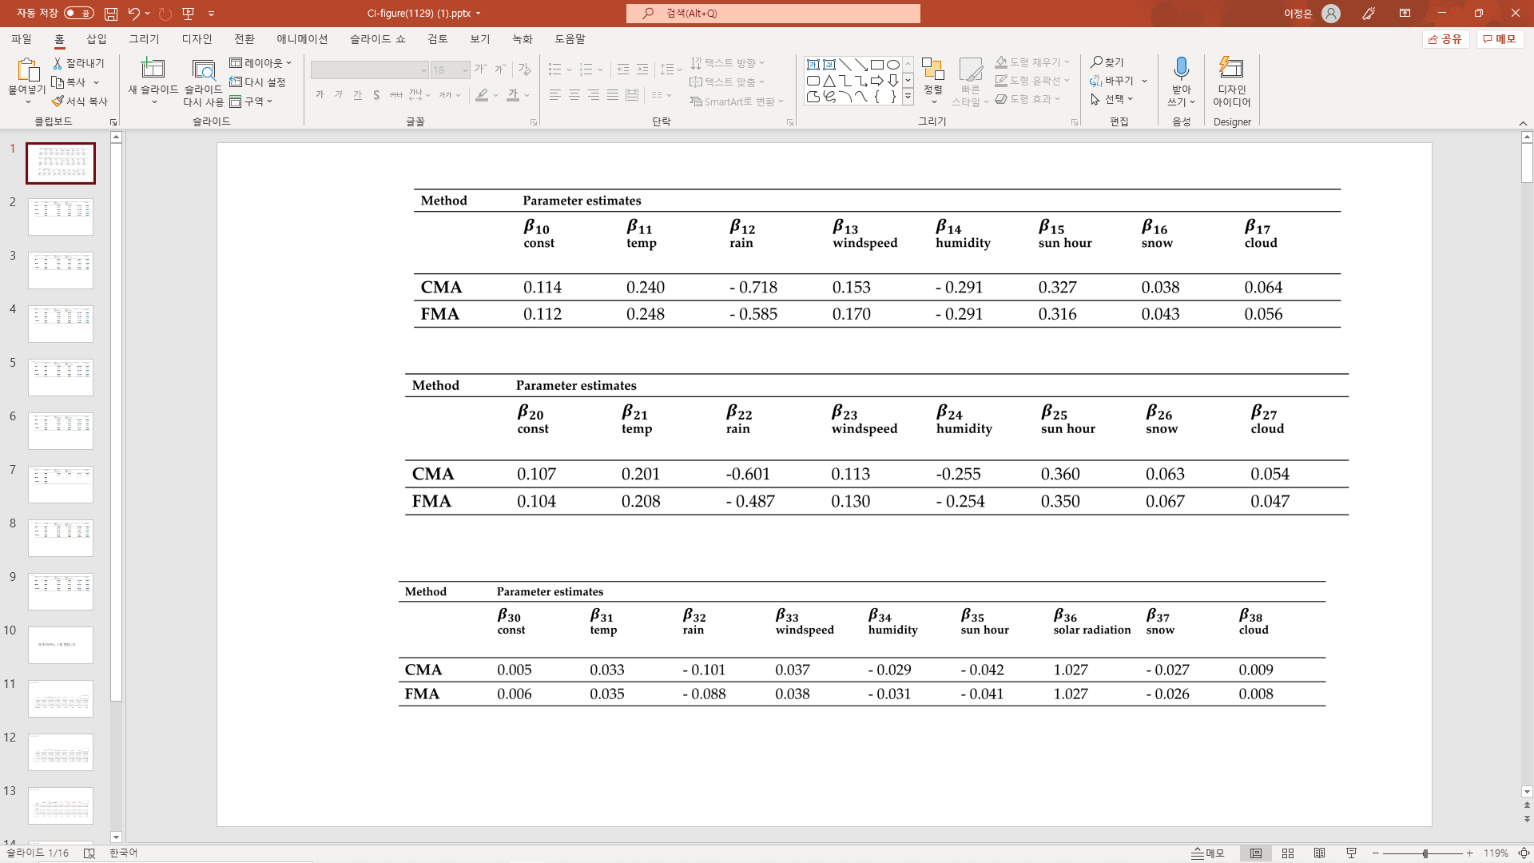
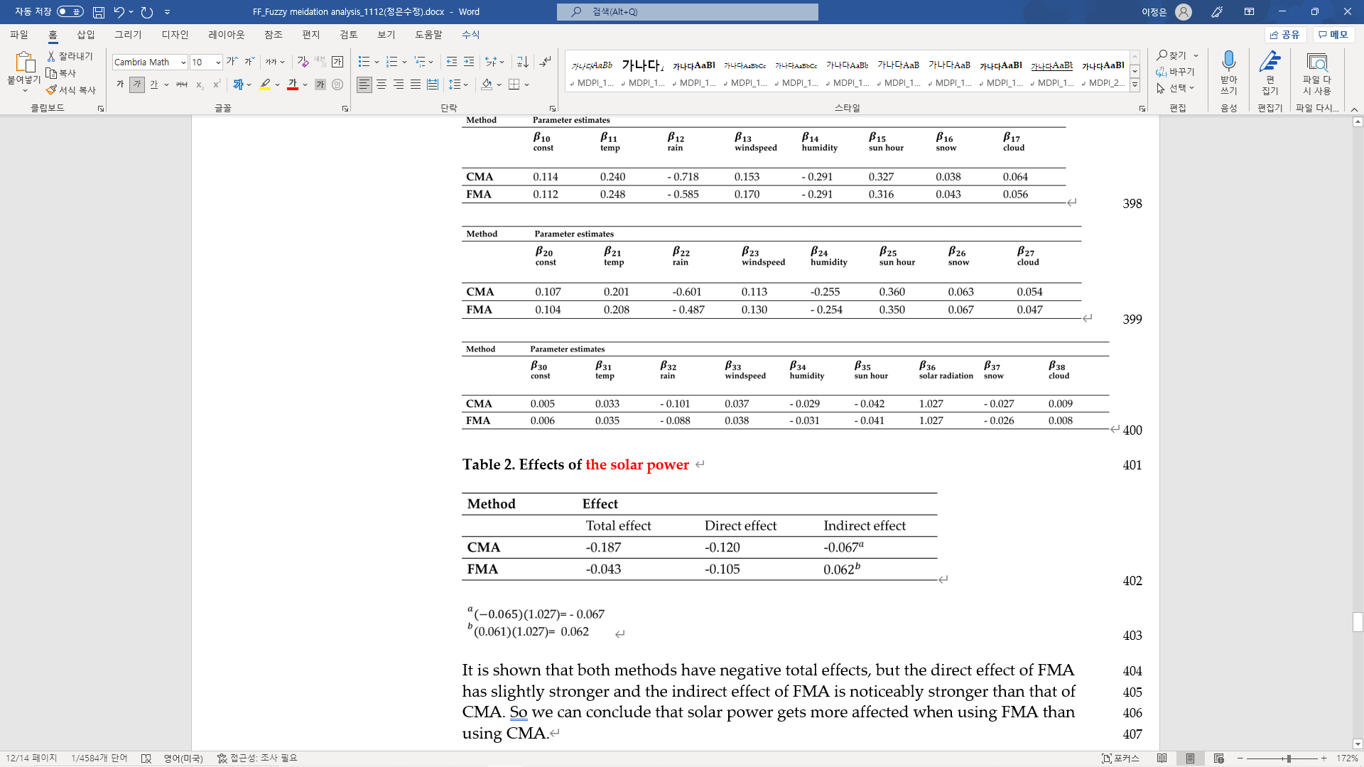
Introduction
Preliminaries
Our study
Result
Conclusion
3. Calculation of coefficients with CMA & FMA and Comparison of their effects
Step 01
CMA : Crisp Mediation Analysis
FMA : Fuzzy Mediation Analysis
Step 02
Step 03
Fuzzy Mediation Analysis
prevents the effects from overestimating

Slide 17
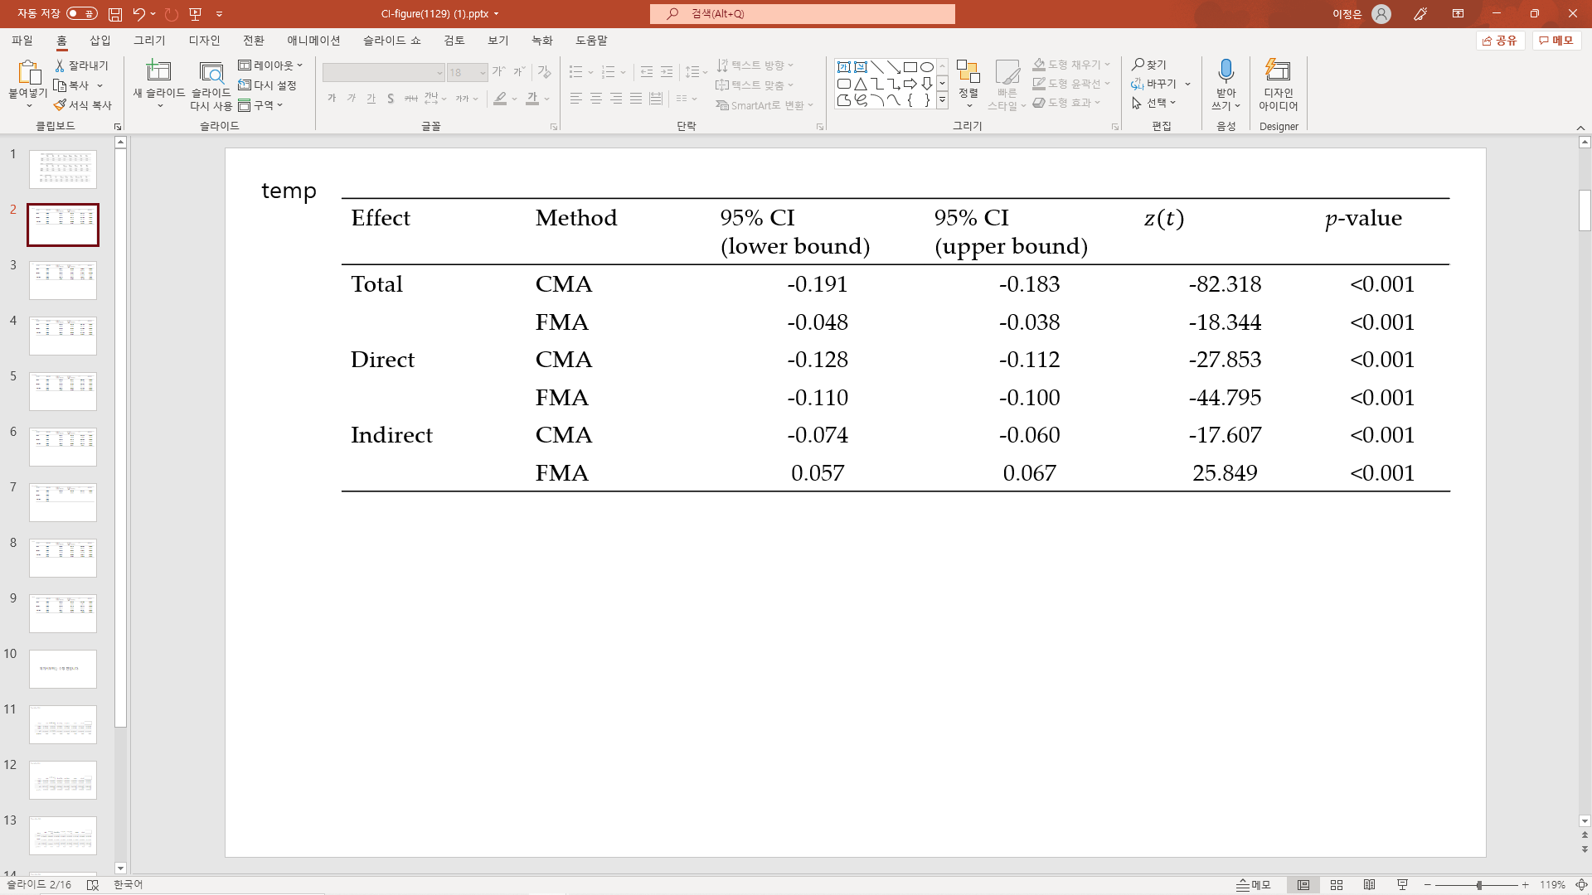
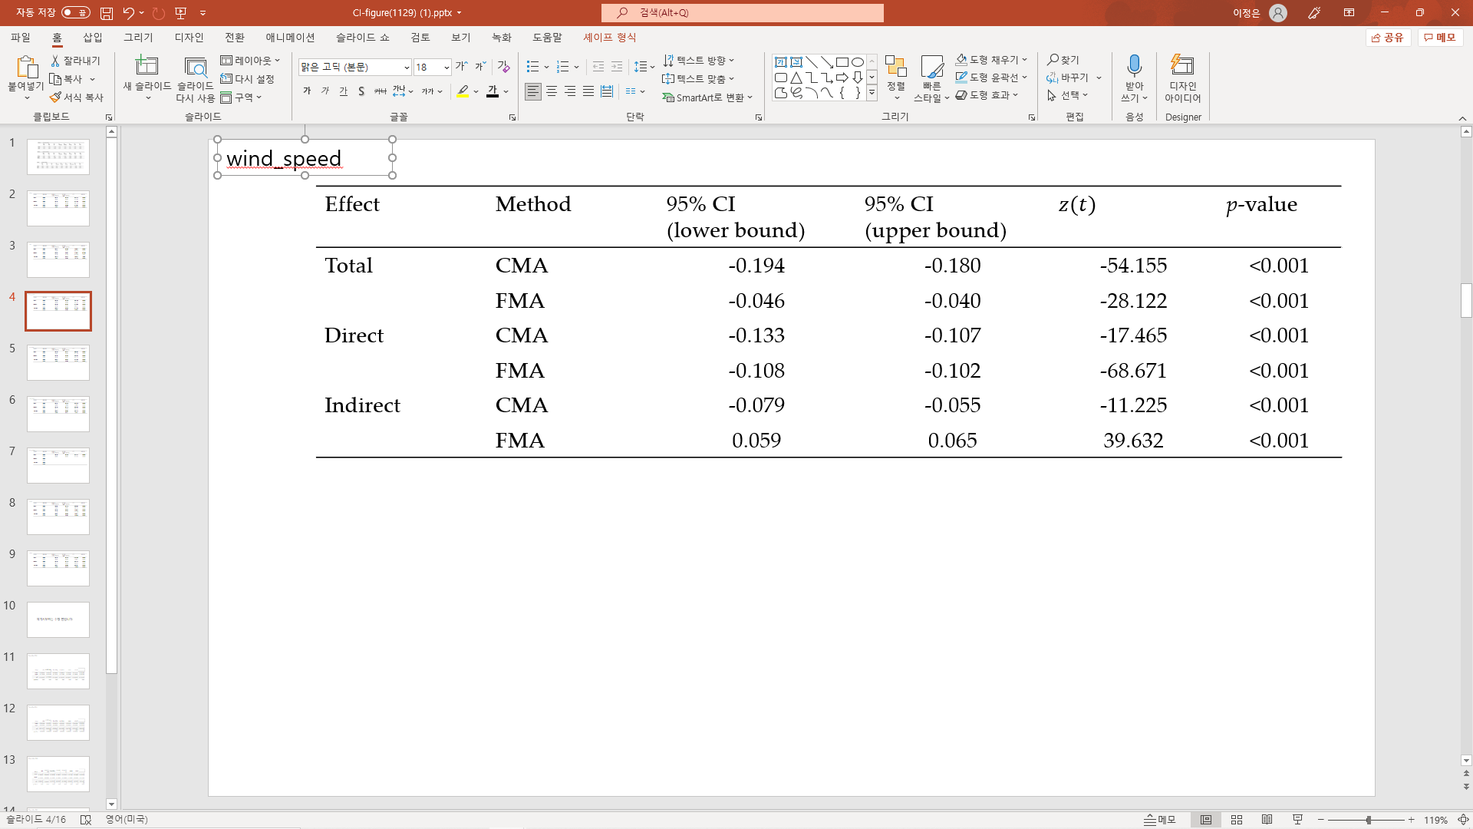
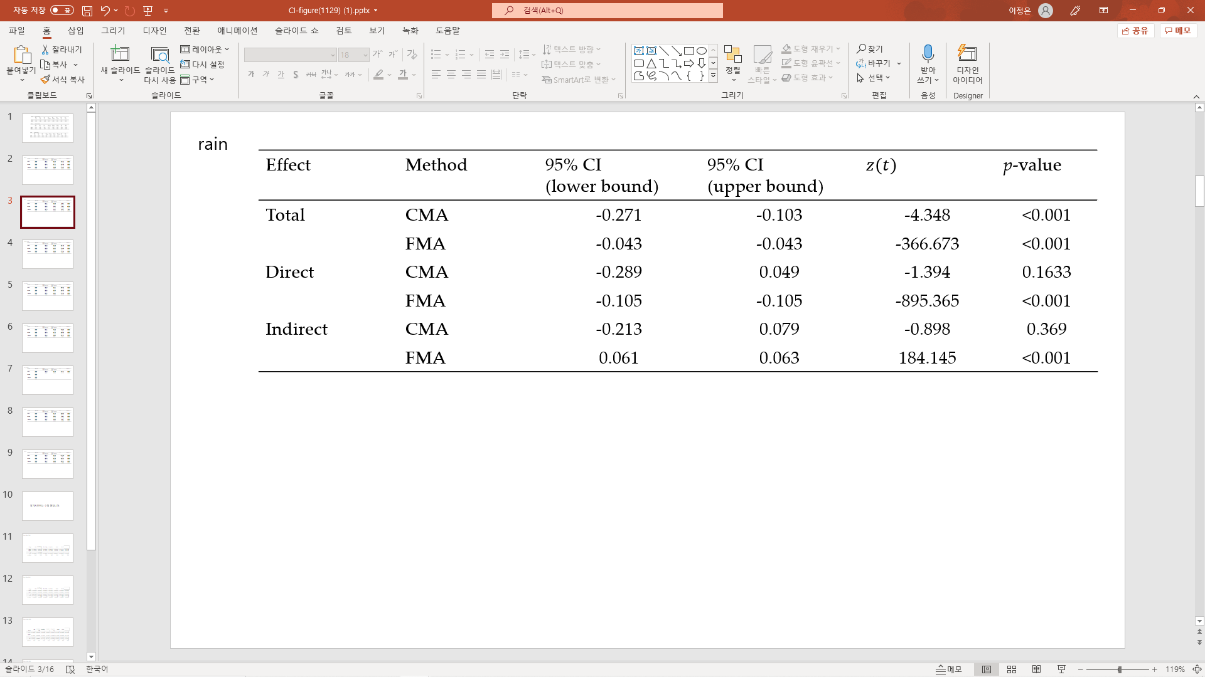
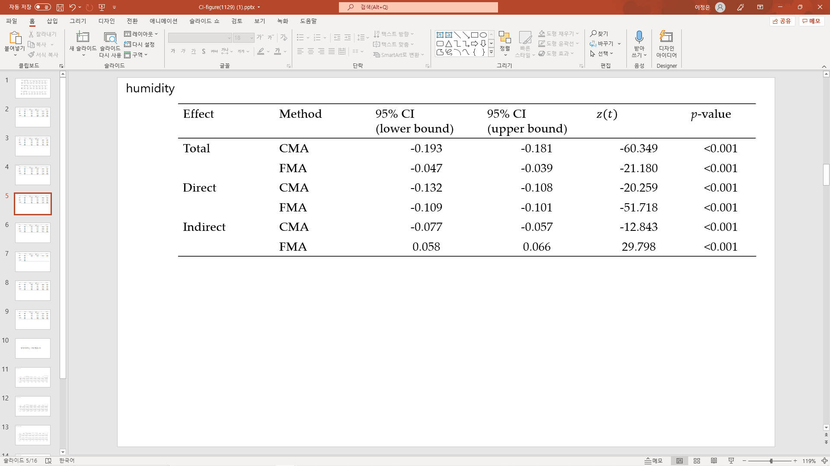
Introduction
Preliminaries
Our study
Result
Conclusion
4. Significance Test of effects with CMA & FMA
temperature
wind speed
rain
humidity

Slide 18
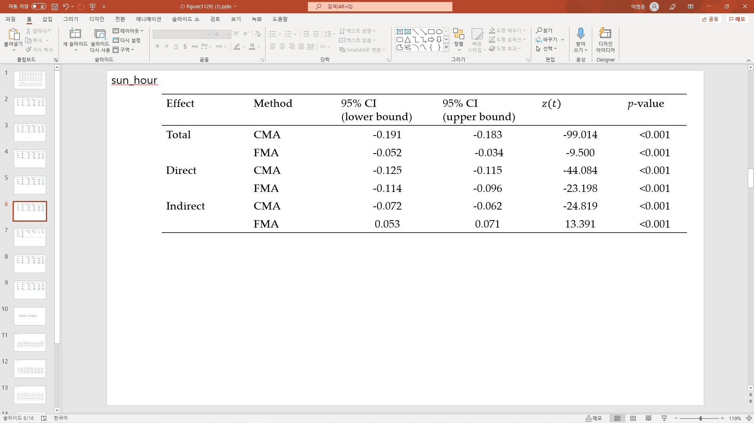
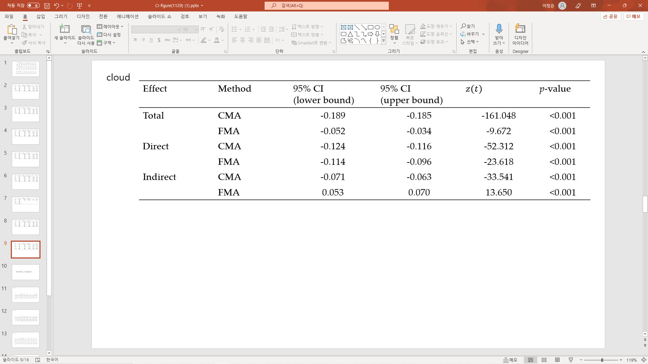
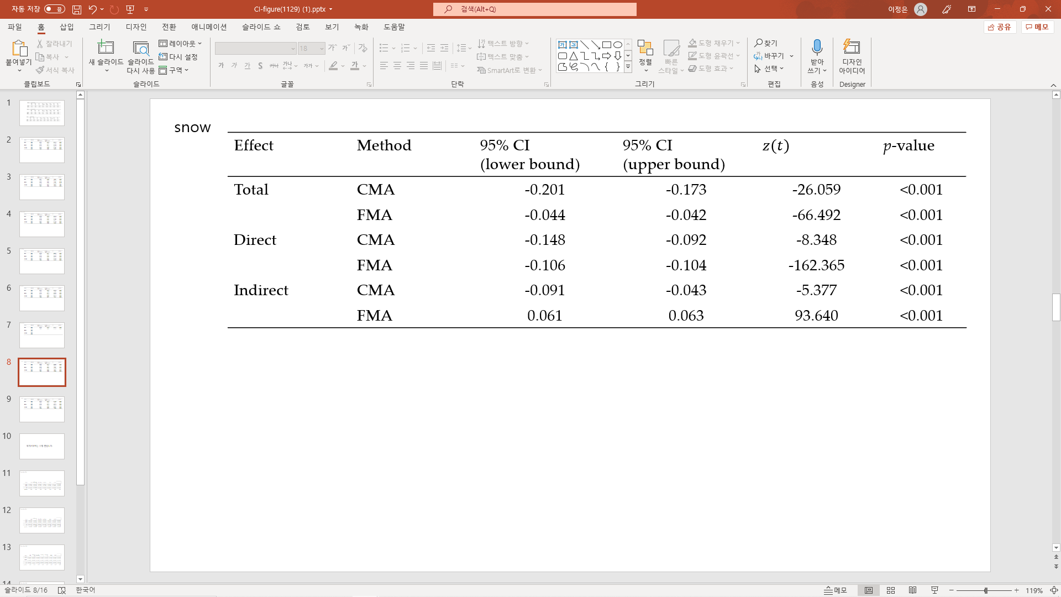

Introduction
Preliminaries
Our study
Result
Conclusion
4. Significance Test of effects with CMA & FMA
sun hour
cloud
snow
Reject $H_{0}$ in all independent variables in FMA
VS
Cannot reject $H_{0}$ in ‘rain’ variable in CMA
☞ Using without considering ambiguous information can lead to biased results

Slide 19

Introduction
Preliminaries
Our study
Result
Conclusion
Summary
Need for study
Data preprocessing
& Modeling
Result
Follow-up study
- Lack of research on the relationships between variables
- Lack of reflection of characteristics of climate information data
Fuzzy Mediation Analysis
- prevents the effects from overestimating
- prevents the effects from biased results
To be extended to
Moderation Analysis,
Mediation-Moderation Analysis, etc.

Slide 20

THANK YOU

